Slide 1

Cyber opps Security Infrastructure

Slide 2
This presentation is designed to identify the security and privacy concerns regarding :
Cyber opps High Value programs
Cyber opps SQL Database for employee and client information
Objective: To determine a strategy based upon a security assessment,
Assign and Implement a framework to provide and accommodate the companies informational protection needs

Slide 3
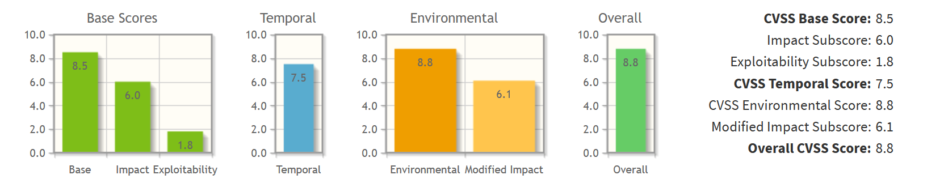
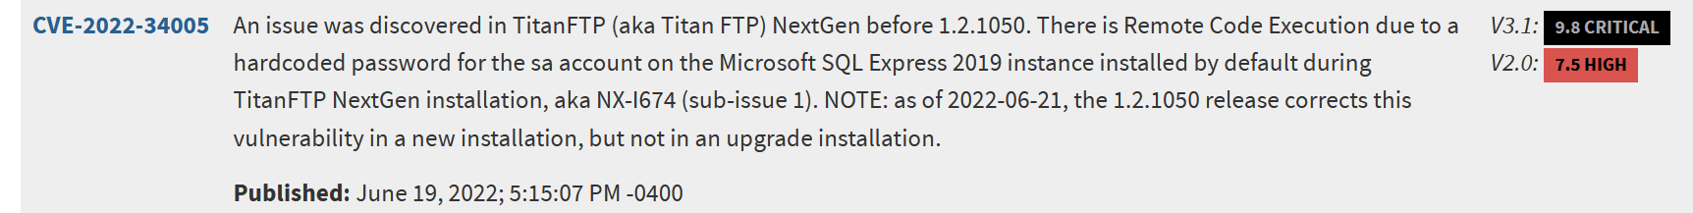
ASSESSMENT
It is known that there is at least one vulnerability on the unpatched SQL Server where the information of employees and clients exist
Also, the most important information to the company is at risk if the issue is not addressed. The CVSS calculator determined that the
information being stored is at high risk because it exist in a non secure environment. The CVE records confirm that with little effort
a threat actor can gain access to the database and compromise the information which would be disastrous to the organization.
At all levels of the CIA Triangle , the company is at the highest risk

Slide 4
Mitigation Details
It is recommended to move the The important and high level information of line to a new
secure server that only Csuite management has access to the data, create back ups on a
timed basis and any one working these specific projects must have authorization
to do so and must be in a controlled environment as these machines must be kept offline
To preserve the data. This will be the best practice to
Address our privacy and information concerns and secure the data.
For the employee and client information server. It must be patched using the update
Provided. By the vendor to ensure that the information stored is safe . A new firewall should
be installed to help prevent an attack from threats outside the network and all employees
with access must to either machine will have new accounts with secure password mangers
To connect or access any machine. All systems will require 2 factor authentication to gain
Access and all security protocols and policies must be reviewed updated and approved
By senior management monthly.

Slide 5

All security protocols and policies must be reviewed, updated and approved
By senior management as any new security concerns, changes to the company
Infrastructure occur or on a Monthly basis . This will ensure that the information is stored to the best of our abilities.

